Slide 1
VQA for order-finding Thesis by Karolis Spukas
Haemanth V
Rohan Sharma

Slide 2
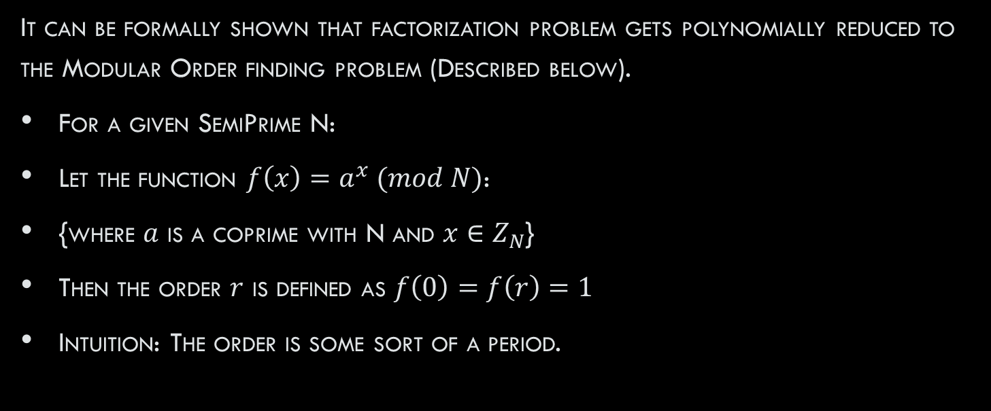
The order Finding Problem
It can be formally shown that factorization problem gets polynomially reduced to the Modular Order finding problem (Described below).
For a given SemiPrime N:
Let the function $f\left(x\right)=a^{x} (mod N)$:
{where $a$ is a coprime with N and $x∈Z_{N}$}
Then the order $r$ is defined as $f\left(0\right)=f\left(r\right)=1$
Intuition: The order is some sort of a period.

Slide 3

TO understand Order better.
Consider the following example:
$x= 1 2 3 4 5 6 7 8 9…………$
$x \left(mod 3\right)= 1 2 0 1 2 0 1 2 0…………$
It is clear from here that there is an associated periodicity with the way numbers appear in the modular arithmetic.
This very period is what we call order. In the above eg. $r$= 3
In SHOR’s factoring algorithm, order finding is the central idea.
The Problem: For the implementation of Shor’s Algorithm, we need 1000’s of fault tolerant qubits and Deep circuits, but we live in the NISQ era.

Slide 4
What now?
We are well versed with the fact that VQAs are best suited for NISQ era hardware
This paper does exactly that.
It discusses implementation of Variational Quantum Algorithms to tackle the Modular Order finding problem.
We shall be discussing 2 of those that involve QAOA.

Slide 5

Algorithm 1:
We first have to convert the order finding problem into an optimization problem for it to be solved using QAOA.
Then introduce a basic cost function $C\left(x\right)=\left(a^{x}−1\right) mod N$
This will always be $≥0$ as $\min\left(a^{x}\right)=1$, so we don’t have to square it.
$\min\left(C\left(x\right)\right)=0$at $x≡0 mod r$
Thus our goal becomes to find an $x \left(≠0\right)$that is as close to a multiple of r as possible.

Slide 6
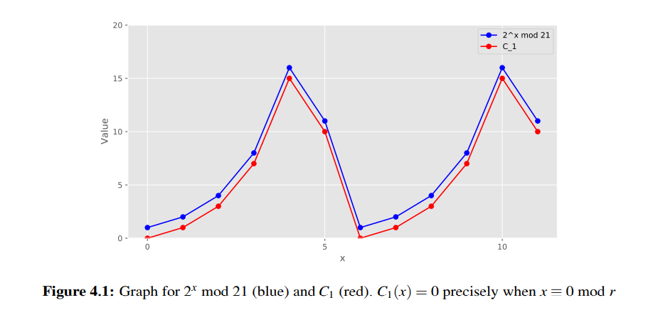
Graph:

Slide 7

Constructing the Hamiltonian.
Once we have the cost function, the next obvious step is to map it to a Hamiltonian.
In order to do that, we need to rewrite it as a PBF [${\left\{0,1\right\}}^{k}→R$] and convert it to a QUBO.
Therefore there are three issues to be tackled in order to achieve H:
The input $x ∈Z_{N}$but we want $x ∈{\left\{0,1\right\}}^{N}$
The exponential term $a^{x}$ needs to be expressed as a polynomial.
The cost function is expressed in terms of modulo N.
To Summarize: the idea is to have a cost function which is QUBO modulo N. Such QUBO could be converted to a Hamiltonian. Modulo would be applied classically after calculating Hamiltonian expectation value and before adjusting circuit parameters.

Slide 8

Tackling issue 1:
We express $x∈Z_{N}$in binary, i.e $\vec{x}$ $=(x_{\left\lfloor \log\left(N\right)\right\rfloor },…,x_{1}, x_{0}$) where $x_{i}∈\left\{0,1\right\}$
Then $a^{x}=a^{{(2}^{0}x_{0}+{2^{1}x}_{1}+2^{2}x_{2}……2^{\left\lfloor \log\left(N\right)\right\rfloor }x_{\left\lfloor \log\left(N\right)\right\rfloor })}$
$a^{x}$can now be written as $a^{x_{0 }}∗a^{2x_{1}}∗a^{{4x}_{2}}……a^{2^{\left\lfloor \log\left(N\right)\right\rfloor }x_{\left\lfloor \log\left(N\right)\right\rfloor }}$
Then $a^{x}= \prod_{i=0}^{\left\lfloor \log\left(N\right)\right\rfloor }{{\left(a^{2^{i}}\right)}^{x_{i}}}$ in compact notation.
So now it’s become a PBF as the x’s take value from {0,1}

Slide 9

Tackling Issue 2:
The advantage of exponentiating with binary variables can be used to convert the function to a polynomial.
The advantage:${ a}^{x_{i}}=1 and a, for x=0 and 1 respectively ; [x_{i}$ $∈\{0,1\}]$
So we can write: $a^{x_{i}}=a∗x_{i}+(1−x_{i})$
So our original equation becomes: $a^{x}= \prod_{i=0}^{\left\lfloor \log\left(N\right)\right\rfloor }{{\left(a∗x_{i}+\left(1−x_{i}\right)\right)}^{2^{i}}+1}$

Slide 10

Tackling Issue 3:
$C\left(x\right)=$($\prod_{i=0}^{\left\lfloor \log\left(N\right)\right\rfloor }{{\left(a∗x_{i}+\left(1−x_{i}\right)\right)}^{2^{i}}+1}$)$−1 mod N.$ It is now a PBF.
It is a HOBO mod N and we have to convert it to a QUBO mod N using Quadrization.
So we state $C\left(x\right)=\begin{aligned}min \\ w\end{aligned}{C^{∗}\left(\vec{x},\vec{w}\right)} for auxiliary variables \vec{w}$
$C$is the HOBO version whereas $C^{∗}$ is the QUBO version of the cost function.

Slide 11

But…….
While we address the issue 2, we should note the fact that on expanding the product we will end up with exponenetially increasing number of terms (depicting interactions within multiple variables of $\vec{x})$
This would directly harm the complexity of our algorithm.
Turns out, there’s no way of reducing${ a}^{x}$to a polynomial with polynomially many terms.
Taylor series ain’t a good idea either. (It approximates in the neighbourhood)
And while addressing issue 3, we realise that the traditional quadratization methods (Freedman & Drineas and Ishikawa) do not work with the modulo operation…. So no $C^{∗}.$

Slide 12
Concluding lines:
Without first converting the PBF to its unique polynomial representation, we can’t convert C to a QUBO. Thich introduces additional overhead.
C* (the QUBO version of the cost function) cannot be obtained due to lack of quadratization methods that deal with modular valued stuff.
So the paper concludes that this algorithm based on QAOA can’t be used to solve the order finding problem.

Slide 13

Algorithm 2
Drawbacks of Algorithm 1
Uses modulo operation
Modified cost function
${C\left(x,k\right)=\left(a^{x}−1 −kN\right)}^{2}, x ϵ Z_{N} and k is some positive integer$
Squaring is chosen over absolute value because quadratization methods like those of Freedman & Drineas and Ishikawa do not work with absolute value operation
Why it works?
Aim to find order $r$ such that $a^{r }≡1(mod N)$
Minimum value of $C(x,k)$ is 0 and is obtained only when $x=0$ or $a^{x}−1=kN$
Should impose an extra constraint so that $x≠0$ to ensure we find a multiple of the order

Slide 14

Converting to PBF
As discussed before, we convert integers x and k to their binary forms
$x=(x_{\left\lfloor \log\left(N\right)\right\rfloor }…x_{1}x_{0})$ and $k =(k_{\left\lfloor \log\left(d\right)\right\rfloor }…k_{1}k_{0})$ in binary for some integer d
$x=\sum_{i=0}^{\left\lfloor log(N)\right\rfloor }{2^{i}x_{i}}$and $k=\sum_{i=0}^{\left\lfloor log(d)\right\rfloor }{2^{i}k_{i}}$
$a^{x}=a^{\sum_{i=0}^{\left\lfloor log(N)\right\rfloor }{2^{i}x_{i}}}= {\prod_{i=0}^{\left\lfloor \log\left(N\right)\right\rfloor }{{(a}^{2^{i}})}}^{x_{i}}$
$a^{x_{i}}=x_{i}\left(a−1\right)+1, x_{i} ϵ \{0,1\}$ and hence $a^{x}= \prod_{i=0}^{\left\lfloor log(N)\right\rfloor }{(x_{i}\left(a^{2^{i}}−1\right)+1)}$
Cost function as PBF
$C\left(x,k\right)=( {\prod_{i=0}^{\left\lfloor \log\left(N\right)\right\rfloor }{(x_{i}\left(a^{2^{i}}−1\right)+1)−1−N\sum_{i=0}^{\left\lfloor \log\left(d\right)\right\rfloor }{2^{i}k_{i}})}}^{2}$

Slide 15

AnalyZing the cost function Before Squaring
$\sum_{i=1}^{\left\lfloor log(N)\right\rfloor +1}{\left({\left\lfloor \log\left(N\right)+1\right\rfloor \atop i}\right)}$ number of positive terms –> consider all possible combinations of $x_{0}, x_{1}, x_{2}, …, x_{\left\lfloor \log\left(N\right)\right\rfloor }$ obtained from $a^{x}= \prod_{i=0}^{\left\lfloor log(N)\right\rfloor }{(x_{i}\left(a^{2^{i}}−1\right)+1)}$
$\left\lfloor log(d)\right\rfloor +1$ number of negative terms –> obtained from $−Nk=−N\sum_{i=0}^{\left\lfloor log(d)\right\rfloor }{2^{i}k_{i}}$

Slide 16

AnalyZing the cost function After squaring
$\sum_{i=1}^{\left\lfloor log(N)\right\rfloor +1}{\left({\left\lfloor log(N)\right\rfloor +1 \atop i}\right)}$ number of positive terms -> from ${\left(a^{x}\right)}^{2} = \prod_{i=0}^{\left\lfloor log(N)\right\rfloor }{{\left(x_{i}\left(a^{2^{i}}−1\right)+1\right)}^{2}}$ and $2∗(−1)∗a^{x}$ both of which will again contain all possible combinations of $x_{0}, x_{1}, x_{2}, …, x_{\left\lfloor \log\left(N\right)\right\rfloor }$
$\sum_{i=3}^{\left\lfloor log(N)\right\rfloor +1}{\left({\left\lfloor log(N)\right\rfloor +1 \atop i}\right)}$ terms have more than 2 variables
The terms are considered positive though we have the negative term $−2a_{x}$ because $a^{2^{i}}−1<2$only when a=2, i=0(so we ignore this only case for the sake of generality)

Slide 17

AnalyZing the cost function After squaring(CONTd.)
$\left\lfloor log(d)\right\rfloor +1$ + $\left({\left\lfloor log(d)\right\rfloor +1 \atop 2}\right)$ number of positive terms –> from $k^{2}={\left(2^{0}k_{0}+2^{1}k_{1}+…+2^{\left\lfloor \log\left(d\right)\right\rfloor }k_{\left\lfloor \log\left(d\right)\right\rfloor }\right)}^{2}$ which yields all possible two variable permutations of $k_{0}, k_{1}, …, k_{\left\lfloor log(d)\right\rfloor }$ and from $2∗\left(−1\right)∗(−Nk)$
$\left\lfloor log(d)\right\rfloor +1$ for all terms involving only one variable from $k_{0}, k_{1}, …, k_{\left\lfloor log(d)\right\rfloor }$(as $k_{i}∈\{0,1\}$ and hence $k_{i}^{2}=k_{i}$)
$\left({\left\lfloor log(d)\right\rfloor +1 \atop 2}\right)$ for all possible combinations of two distinct variables from $k_{0}, k_{1}, …, k_{\left\lfloor log(d)\right\rfloor }$
All terms have atmost 2 variables(quadratized already)

Slide 18

AnalyZing the cost function After squaring(CONTd.)
($\left\lfloor log(d)\right\rfloor +1)\sum_{i=1}^{\left\lfloor log(N)\right\rfloor +1}{\left({\left\lfloor log(N)\right\rfloor +1 \atop i}\right)}$ number of negative terms –> from $2∗a^{x}∗\left(−Nk\right)=−2N∗\sum_{i=0}^{\left\lfloor \log\left(d\right)\right\rfloor }{2^{i}k_{i}}∗\prod_{j=0}^{\left\lfloor log(N)\right\rfloor }{x_{j}\left(a^{2^{j}}−1\right)+1}$ which yields all possible combinations of $x_{0}, x_{1}, …, x_{\left\lfloor \log\left(N\right)\right\rfloor }$ and any 1 variable from $k_{0}, k_{1}, …, k_{\left\lfloor \log\left(d\right)\right\rfloor }$
Of these terms, ($\left\lfloor log(d)\right\rfloor +1)\sum_{i=2}^{\left\lfloor log(N)\right\rfloor +1}{\left({\left\lfloor log(N)\right\rfloor +1 \atop i}\right)}$ number of terms have more than 2 variables

Slide 19

Number of auxiliary variables
Using Ishikawa’s method, quadratizing a positive term of degree l requires $\left\lfloor \frac{\left(l−1\right)}{2}\right\rfloor$ variables
Total number of positive terms of degree more than 2 = $\sum_{i=3}^{\left\lfloor log(N)\right\rfloor +1}{\left({\left\lfloor log(N)\right\rfloor +1 \atop i}\right)}$
Thus number of auxiliary variables for positive terms = $\sum_{i=3}^{\left\lfloor log(N)\right\rfloor +1}{\left({\left\lfloor log(N)\right\rfloor +1 \atop i}\right) }$* $\left\lfloor \frac{\left(i−1\right)}{2}\right\rfloor$

Slide 20

Number of auxiliary variables(CONTD.)
Using Freedman & Dinneas method, quadratizing a negative term requires 1 variables
Total number of negative terms of degree more than 2 = ($\left\lfloor \log\left(d\right)\right\rfloor +1)\sum_{i=2}^{\left\lfloor log(N)\right\rfloor +1}{\left({\left\lfloor log(N)\right\rfloor +1 \atop i}\right)}$
Thus number of auxiliary variables for negative terms = ($\left\lfloor \log\left(d\right)\right\rfloor +1)\sum_{i=2}^{\left\lfloor log(N)\right\rfloor +1}{\left({\left\lfloor log(N)\right\rfloor +1 \atop i}\right)}$

Slide 21

TOTAL Number of variables/QUBITs
We use 1 qubit for each variable
For x, we use $x_{0}, x_{1}, …, x_{\left\lfloor \log\left(N\right)\right\rfloor }= \left\lfloor \log\left(N\right)\right\rfloor +1$ variables
For k, we use $k_{0}, k_{1}, …, k_{\left\lfloor \log\left(d\right)\right\rfloor }= \left\lfloor \log\left(d\right)\right\rfloor +1$ variables
Thus total number of qubits required(including auxiliary qubits) are $\left\lfloor \log\left(N\right)\right\rfloor +1+$ $\left\lfloor \log\left(d\right)\right\rfloor +1$ + $\sum_{i=3}^{\left\lfloor log(N)\right\rfloor +1}{\left({\left\lfloor log(N)\right\rfloor +1 \atop i}\right)}$* $\left\lfloor \frac{\left(i−1\right)}{2}\right\rfloor$ + ($\left\lfloor \log\left(d\right)\right\rfloor +1)\sum_{i=2}^{\left\lfloor log(N)\right\rfloor +1}{\left({\left\lfloor log(N)\right\rfloor +1 \atop i}\right)}$
Note: Adding a constraint to ensure $x≠0$ will not introduce new terms and will only affect the scalar coefficients of existing terms

Slide 22

Challenges AND CONCLUSION
Algorithm works but it introduces exponentially many variables – $O\left(\left\lfloor \log\left(d\right)\right\rfloor ∗2^{\left\lfloor \log\left(N\right)\right\rfloor }\right)=O(\left\lfloor \log\left(\frac{a^{N−1}−1}{N}\right)\right\rfloor ∗2^{\left\lfloor \log\left(N\right)\right\rfloor })$ but our goal is to only find the $\left\lfloor log(N)\right\rfloor +1$ variables in the binary representation of x. The smallest instance considered in the chapter, uses 8 qubits of which only 2 qubits encode x.
Hence it is not suitable for practical applications(has scaling limitations)
Moreover, this algorithm may give us a multiple of the order and not the order itself.

